Slide 1


Infrastructure Investment & Jobs Act Funding Allocation
Evaluating Equity and Political Bias
Investigation Focus: The analysis aims to determine if funding allocation is proportionate to population across states and territories, and if allocation favor the political interests of the Biden administration.
Data 608- Story 1
-YINA QIAO

Slide 2
Infrastructure Investment & Jobs Act Funding Allocation
Evaluating Equity and Political Bias
Data Utilized: The analysis utilizes current funding allocation data, population estimates, and 2020 Presidential election results to provide a comprehensive view of the funding landscape
Data 608- Story 1
-YINA QIAO

Slide 3
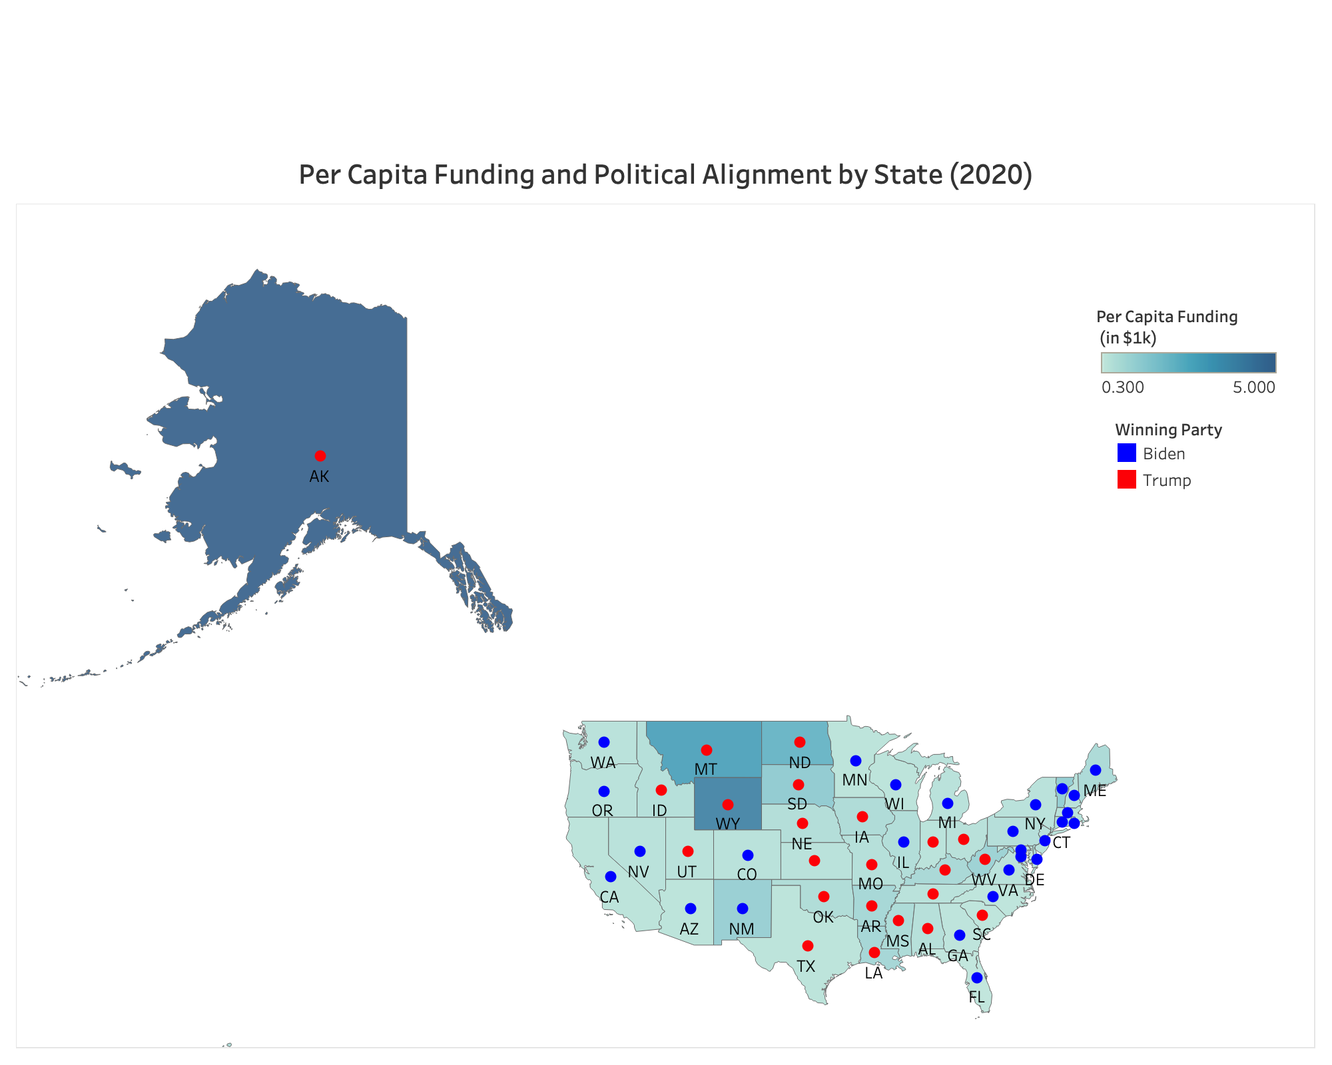
Per Capita Funding and Political Alignment by State (2020)

Slide 4
Per Capita Funding and Political Alignment by State (2020)
Integrated Analysis: This map merges per capita funding data with the 2020 election results, providing a single, powerful visual of how funding relates to political outcomes across states
Interpretation Key: Dot size indicates funding magnitude, with color signifying the winning party—blue for Biden and red for Trump—offering immediate insight into the funding-political landscape.
‎

Slide 5
Conclusion
Equity in Infrastructure Funding
Equity in Allocation: Ideally, funding per person should be similar everywhere, but it's not. States like Alaska, Wyoming, Montana, despite their lower populations, receive high funding per capita, possibly due to their vast land areas and unique infrastructural demands.
Political Neutrality: The data suggests that the allocation of funds does not systematically favor states based on their 2020 presidential election outcomes, implying a level of political neutrality in the distribution process.
Final Thoughts: Overall, the funding allocation appears to be influenced by a variety of factors, with no clear evidence of bias towards political interests of the Biden administration.

Slide 6
reference
Equity in Infrastructure Funding
https://www.census.gov/data/tables/time-series/demo/popest/2020s-state-total.html
https://www.archives.gov/electoral-college/2020
https://en.wikipedia.org/wiki/2020_United_States_presidential_election

